Slide 1

CHM 5175: Part 2.6
Time-resolved emission
Source
Clock
hν
Sample
Detector
Ken Hanson
MWF 9:00 – 9:50 am
Office Hours MWF 10:00-11:00

Slide 2
Steady-state Emission
Source
Sample
Intensity vs. Wavelength
hν
hν
S₁
Constant Excitation
Non-
emissive decay
Constant Emission
Energy
S₀
Equilibrium between absorption, non-emissive decay and emission.
Information about emission intensity (yield) and wavelength.

Slide 3
Time-resolved Emission
Source
Sample
hν
hν
Intensity vs. Time
Short Burst of Light
S₁
Pulsed Excitation
k_{nr}
k_{r}
Energy
S₀
Competition between non-emissive decay and emissive rates.
Information about emission lifetimes.

Slide 4
Single Molecule Emission
Excited state Lifetime:
Time spent in the excited state (S₁) prior to radiative (k_{r}) or non-radiative decay. (k_{r})
Anthracene
S₁
Energy
Ex
Em
Ex
Em
Ex
S₀
Time
Excited State Lifetime of an individual molecule: 0 – infinity

Slide 5
Ensemble Emission
Single Molecule Emission
Time-resolved Emission
Intensity vs. Time
Excited State Lifetime of an individual molecule: 0 – infinity
S₁
Energy
Ex
Em
Ex
Em
Ex
S₀
Observe many single molecule emission events!
Time

Slide 6
Ensemble Emission
32 excited states
+ 32 photons
64 excited states
hν
Time 1
Time 2
Time 4
Time 3
4 excited states
+ 4 photons
8 excited states
+ 8 photons
16 excited states
+ 16 photons
Time 5
etc.

Slide 7
Ensemble Emission
64 excited states
32 excited states
+ 32 photons
hν
Time 1
Time 2
Time 4
Time 3
4 excited states
+ 4 photons
8 excited states
+ 8 photons
16 excited states
+ 16 photons
Time 5
etc.
32 photons
16 photons
8 photons

Slide 8
Excited State Decay Curve
n*(0) is the # of the excited state at time 0
n*(t) is the # of the excited state at time t
τ is the lifetime of the excited state
S₁
Pulsed Excitation
k_{nr}
k_{r}
Energy
1
τ
=
S₀
k_{r} + k_{nr}
We don’t get to count the number of excited state molecules!

Slide 9
Intensity Decay Curve
I(t)
= e^{-t/τ}
I(0)
I(0) is the initial intensity at time zero
I(t) is the intensity at time t
τ is the lifetime of the excited state
1
τ
=
k_{r} + k_{nr}
τ = time it takes for 63.2 % of excited states to decay
τ should always be the same for a given molecule under the same conditions

Slide 10
Intensity Decay Curve
Linear Scale
Log Scale
1.00 --
Emission
Exciting pulse
Log intensity
intensity
Emission
1/e
Exciting pulse
τ
time
time
I(t)
= e^{-t/τ}
I(0)

Slide 11
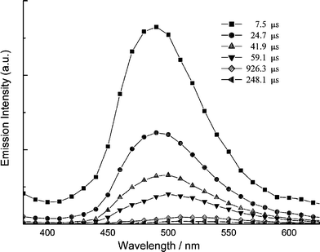
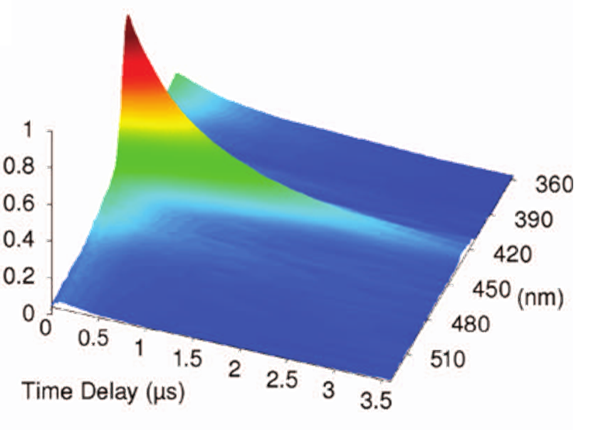
Spectra Decay
intensity
I(t)
= e^{-t/τ}
I(0)

Slide 12
Why do we care about lifetimes?
Electron transfer rates
Energy transfer rates
Distance dependence
Distinguish static and dynamic quenching
Fluorescence resonance energy transfer (FRET)
Track solvation dynamics
Rotational dynamics
Measure local friction (microviscosity)
Track chemical reactions
k_{r} and k_{nr} (if you know Φ)
GFP- Nobel prize, expression studies
Sensing

Slide 13
Lifetime Measurements
Source
Sample
hν
hν
Frequency Domain
Time Domain
Light source
Light source
Intensity
Intensity
time
time
Harmonic or phase-modulation method
Pulsed Method

Slide 14
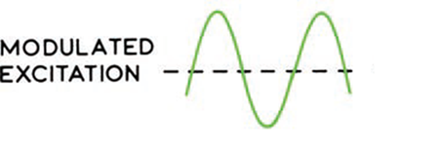
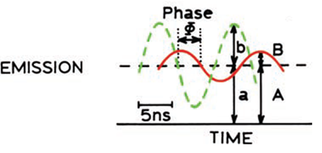
Frequency-domain Method
Measure Events with Respect to Frequency
Time
Sample
Low I₀ Excitation
hν
hν
I₀
hν
High I₀ Excitation
hν
Low I₀ Excitation
hν
hν

Slide 15
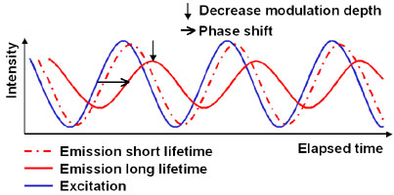
Frequency-domain Method

Slide 16
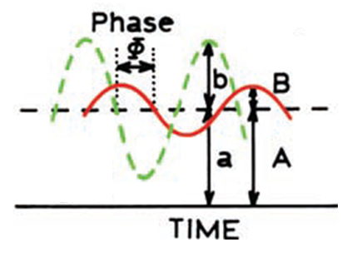
Frequency-domain Method
a
Excitation Modulation =
b
a = average intensity
b = average-to-peak intensity
A
Emission Modulation =
B
A = average intensity
B = average-to-peak intensity
(B/A)
Modulation (m) =
(b/a)
Phase Shift (φ)

Slide 17
Frequency-domain Method
Ex Frequency (ϖ)
Modulation (m)
Phase Shift (φ)
Phase (τ_{φ}) and modulation (τ_{m}) lifetimes
Changing ϖ, measuring m and φ to calculate lifetime.

Slide 18
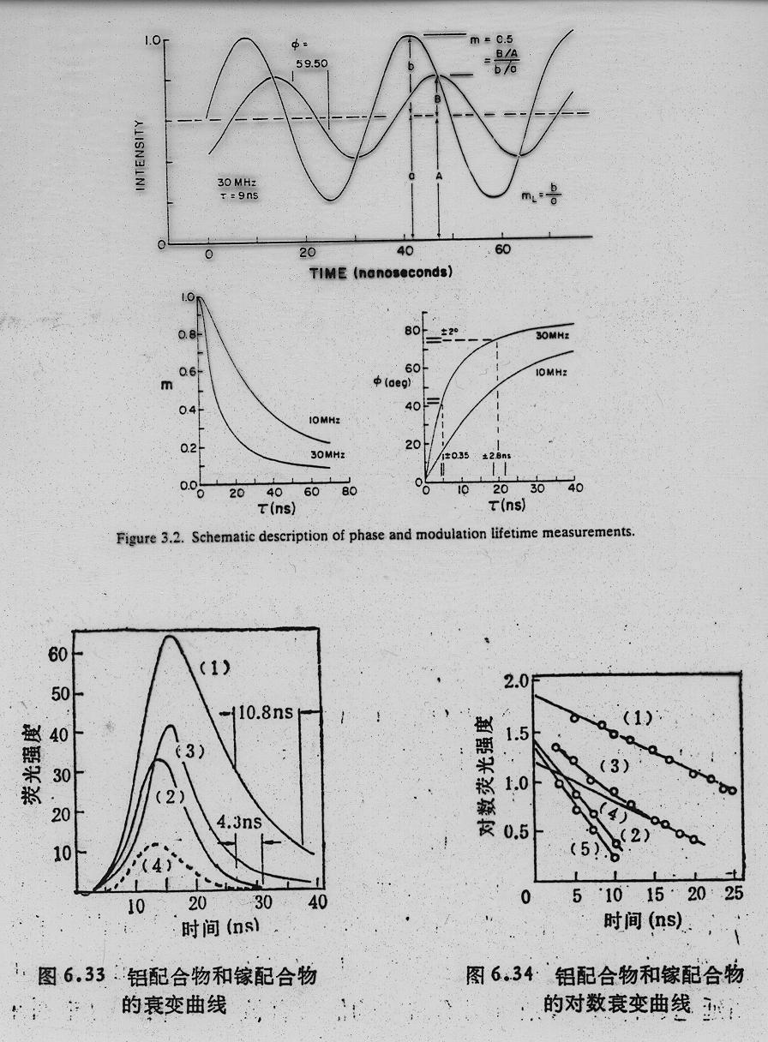
Frequency-domain Method

Slide 19
Frequency-domain Method
Lifetimes as short as 10 picoseconds
Can be measured with a continuous source
Tunable from the UV to the near-IR
Frequency domain is usually faster than time domain (same source)

Slide 20
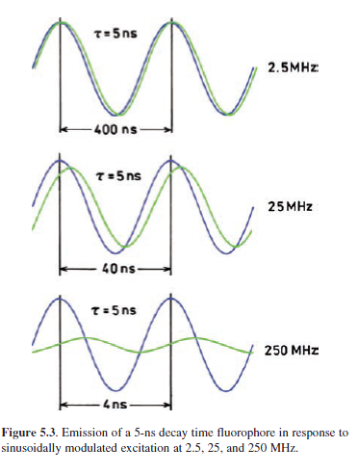
Frequency-domain Method
Ex Frequency (ϖ)
Modulation (m)
Phase Shift (φ)
ϖ
φ
ϖ
m

Slide 21
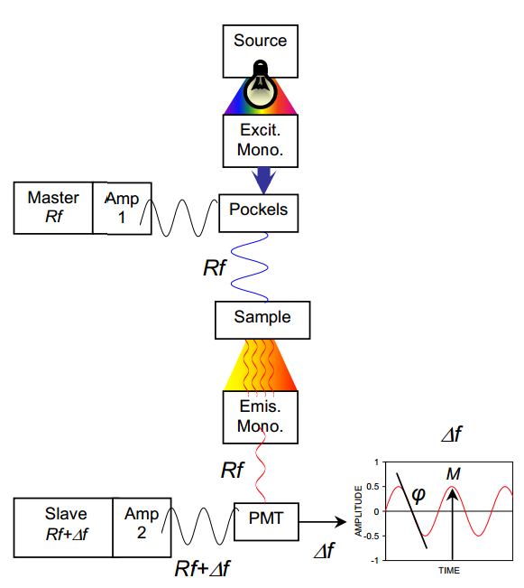
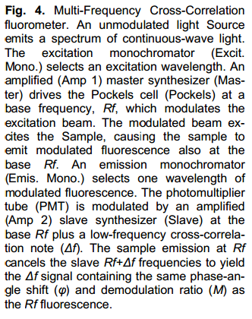
Frequency-domain Instrument

Slide 22
Frequency-domain Method
List of Commercially Available Frequency-domain Instruments

Slide 23
Lifetime Measurements
Source
Sample
hν
hν
Frequency Domain
Time Domain
Light source
Light source
Intensity
Intensity
time
time
Harmonic or phase-modulation method
Pulsed Method

Slide 24
Time-Domain Method
Measure Events with Respect to Time
Light source
Emission intensity is measured following a short excitation pulse
Intensity
Emission
time
Pulsed method
Lifetimes as short as 50 fs
Multiple measurement techniques
Sources typically not as tunable as frequency domain

Slide 25
Time-domain Techniques
Excitation
Intersystem Crossing
Fluorescence
Phosphorescence
Internal Conversion
1 fs
1 ps
1 ns
1 μs
1 ms
1 s
femto
pico
nano
micro
milli
seconds
0.000 000 001 s
0.000001 s
0.001 s
1 s
0.000 000 000 001 s
0.000 000 000 000 001 s

Slide 26
Time-domain Techniques
TCSPC
Streak Camera
Real-time Measurement
MCS
Up-conversion
Strobe
1 fs
1 ps
1 ns
1 μs
1 ms
1 s

Slide 27
Time-domain Techniques
Real-Time lifetime measurement (τ > 200 ps)
Multi-channel scaler/photon counter (τ > 1 ns)
Strobe –Technique (τ > 250 ps)
Time-correlated single-photon counting (τ > 20 ps)
Streak-camera measurements (τ > 2 ps)
Fluorescence up-conversion (τ > 150 fs)

Slide 28
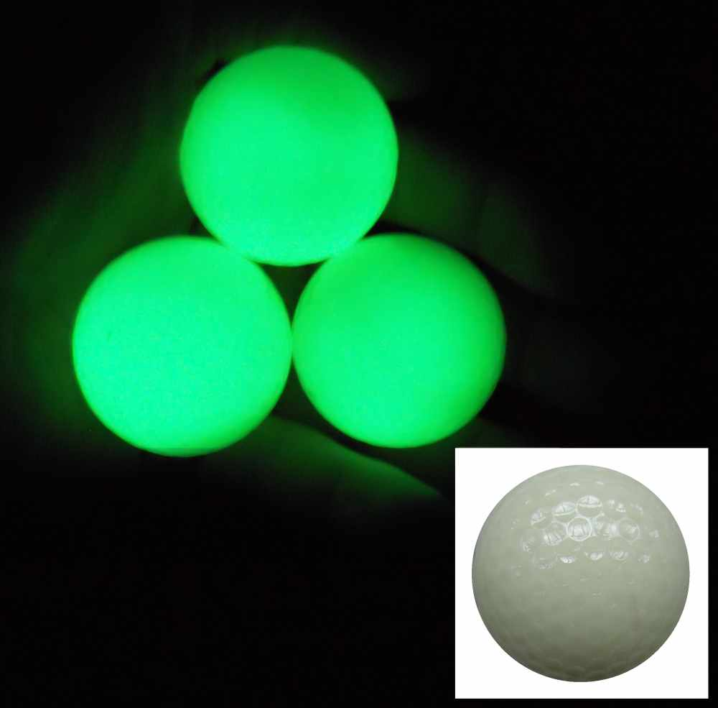
Real-Time Lifetime
hν

Slide 29
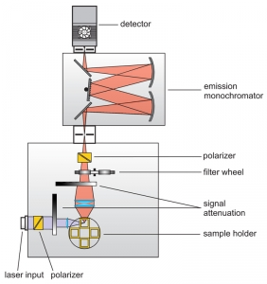
Real-Time Lifetime
Source
Clock
(4)
hν
Detector
(3)
Sample
Monochromator
1) Pulsed excitation
2) Sample excitation/emission
3) Monochromator
4) Detector signal
5) Plot Signal vs. Time
(1)
(2)

Slide 30
Real-Time Lifetime
Light source
Sources
Flashlamp
Laser
Pulsed LED
Detector Current
Emission
time

Slide 31
Real-Time Lifetime
Instrument Response Function (IRF)
Detector Current
Emission
time
Make excitation pulse width as short as possible
Time resolution is usually detector dependent
Excited-state lifetime > IRF
Lifetimes > 200 ps

Slide 32
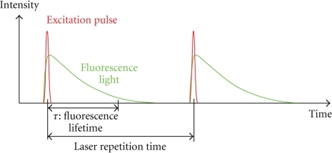
Real-Time Lifetime
100 averages

Slide 33
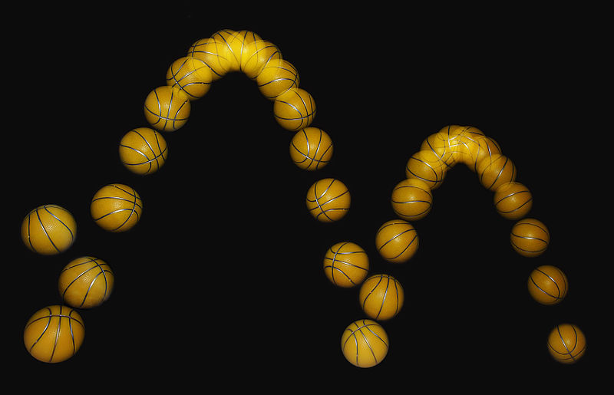
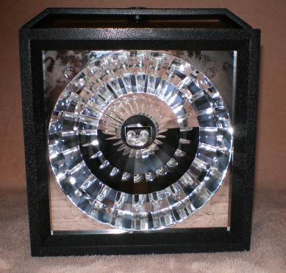

Strobe-Technique
25 images per second

Slide 34
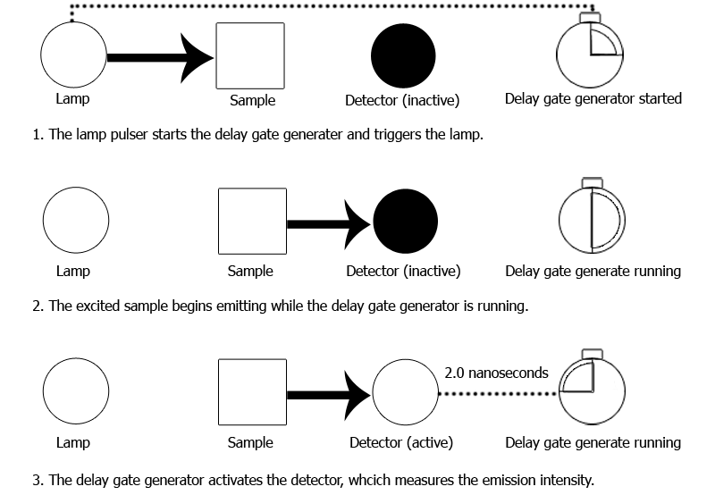
Strobe-Technique
Photon Technology International (PTI)

Slide 35
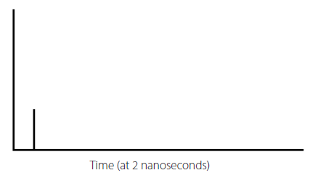
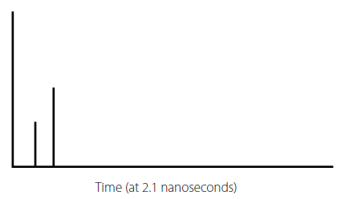
Strobe-Technique
Light Pulse
Measurement Window
time
Light Pulse
Measurement Window
time

Slide 36
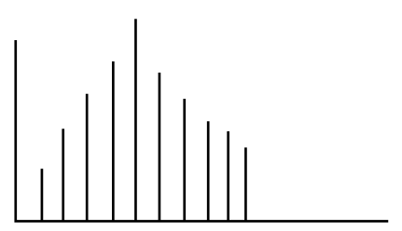
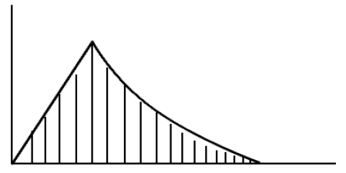
Strobe-Technique
Light Pulse
Measurement Window
time
time
Detector Signal
time

Slide 37
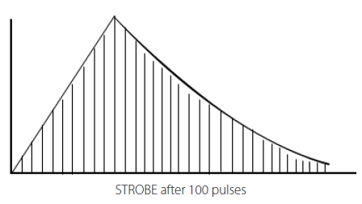
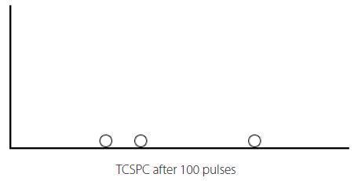
Strobe-Technique
Strobe-Technique
TCSPC
“Full decay curve is attainable after just one sweep (100 pulses)”
“TCSPC: for every 100 pulses, you get only up to three useful points”
“The Strobe technique is much faster than the TCSPC technique for generating the decay curve. This is particularly important in the life science area. Whereas the chemist can take hours or days to measure an inert chemical very accurately, the life scientists’ cell samples are long dead. “
Lower Time Resolution

Slide 38
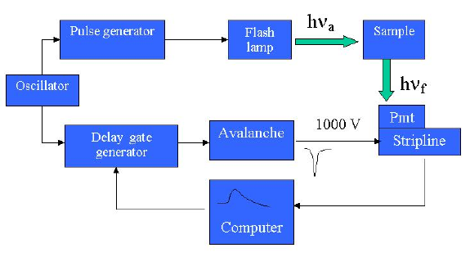
Strobe-Technique
(2)
(1)
(3)
(4)
1) Trigger Signal
2) Excitation Flash
3) Detector Signal Delay
4) Detect
5) Output
(5)
τ > 250 ps

Slide 39
Time-Correlated Single-Photon Counting (TCSPC)
S₁
Energy
Ex
Em
Ex
Em
Ex
S₀
Time
Excited State Lifetime of an individual molecule: 0 – infinity
The sum an individual molecule lifetimes = τ

Slide 40

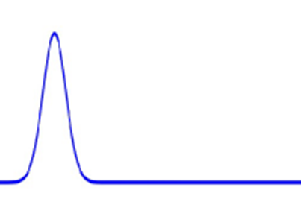
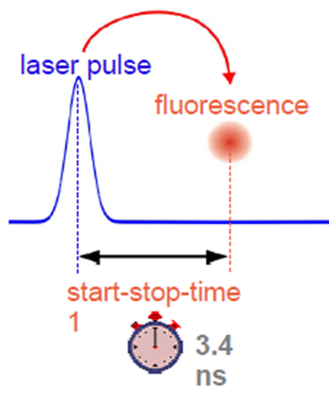
Time-Correlated Single-Photon Counting (TCSPC)
Low excitation intensity:
- Low number of excited state
- 20-100 pulses before emission is detected
- Only one or 0 photons detected per pulse
- Simulated single molecule imaging
Time

Slide 41
Time-Correlated Single-Photon Counting (TCSPC)
1) Pulsed source “starts” the timing electronics
2) Timer “stopped” by a signal from the detector
3) The difference between start and stop is sorted into “bins.”
-Bins are defined by a Δt after pulse at t = 0
Detector Bins
Time

Slide 42
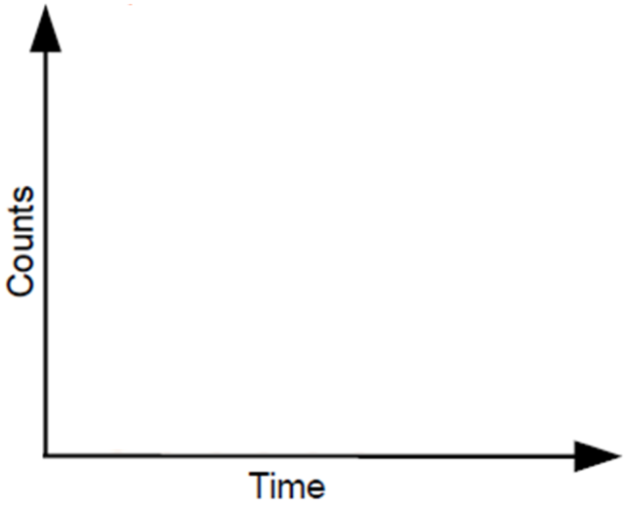

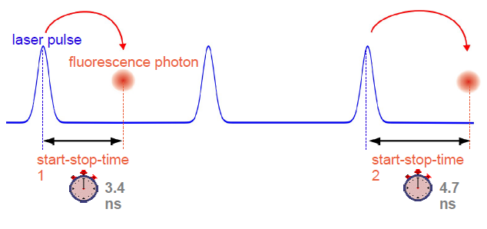
Time-Correlated Single-Photon Counting (TCSPC)
Sum the Photons per Bin
Detector Bins
Time

Slide 43
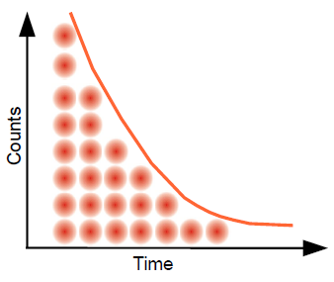
Time-Correlated Single-Photon Counting (TCSPC)
Repeat
Probability Distribution

Slide 44
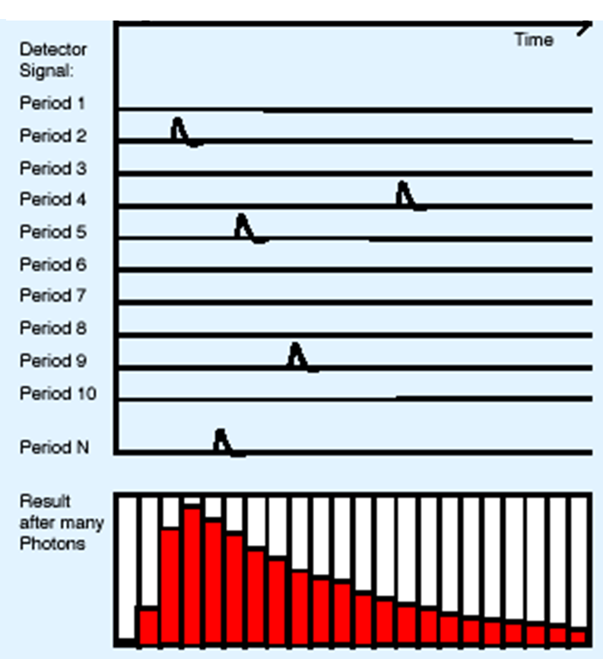
Time-Correlated Single-Photon Counting (TCSPC)
Excitation Pulse

Slide 45
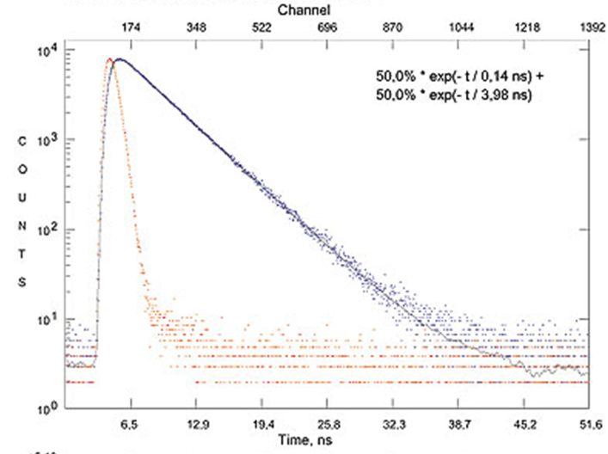
Time-Correlated Single-Photon Counting (TCSPC)
Repeat: 10,000 counts in the peak channel

Slide 46
Time-Correlated Single-Photon Counting
Source:
Flash lamp
solid state LED
laser
1) Pulsed excitation (10kHz)
2) Monochromator
3) Beam Splitter
1) to trigger PMT
2) to sample
4) Excite Sample
5) Sample emits into monochromator
6) Emission hits PMT and timer stops
7) Repeat a million times
pulsed source
(1)
(2)
exc. monochromator
Start PMT
Δt
(3)
(3)
emission monochromator
Stop PMT
sample
(4)
(6)
(5)

Slide 47
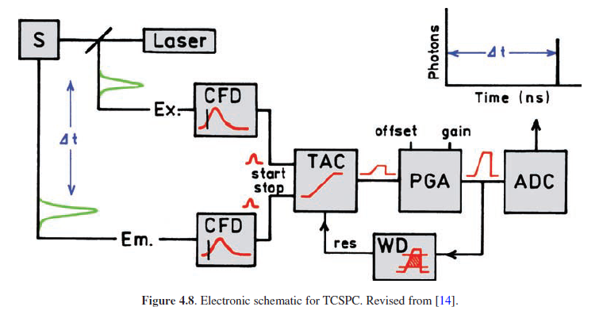
TCSPC
1) Pulsed excitation
2) Ex CFD triggers TAC
3) TAC voltage rises
4) Em CFD stops TAC
5) TAC discharges to PGA
6) PGA siganl to ADC for a single data point
constant function discriminator (CFD)
time-to-amplitude converter (TAC)
programmable gain amplifier (PGA)
analog-to-digital converter (ADC)

Slide 48
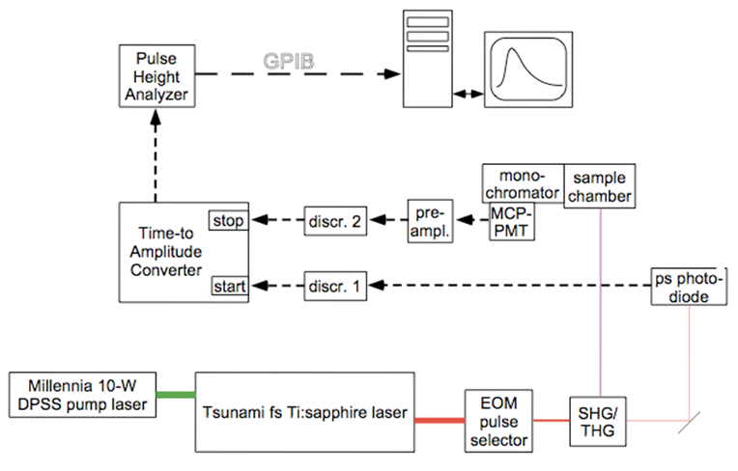
TCSPC
48

Slide 49
TCSPC
Advantages:
High sensitivity
Large dynamic range (3-5 decades)
Well defined statistics
Temporal resolution down to 20 ps
Very sensitive (low emission materials)
Time resolution limited by detector
Price as low as $15 K
Disadvantages:
“Long” time to acquire data
Complicated electronics
Stray light
Lifetimes < 10 μs
Resolution vs. acquisition time
Molecule with a 10 ms lifetime
10,000 peak counts
1024 bins for a 20 ms window
Total counts = 4,422,800
20 ms rep rate
1 count per 20 reps
= 20.5 day measurement

Slide 50
Resolution vs. Acquisition Time
Detector Bins
Detector Bins
Time
Time
5 ns wide bin = 5 ns resolution
10 minutes to acquire 10,000 counts
1 ns wide bin = 1 ns resolution
50 minutes to acquire 10,000 counts
Resolution
Acquisition Time
Resolution
Acquisition Time

Slide 51

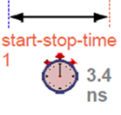
Repetition Rate to High
hν
hν
Real
start-stop-time
Time

Slide 52
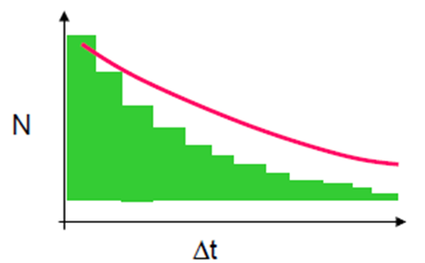
Repetition Rate to High
Signal
time
If the rep rate is too high the histogram is biased to shorter times!
Measured τ < Real τ
Keep rep rate at least 10 times slower than your τ

Slide 53
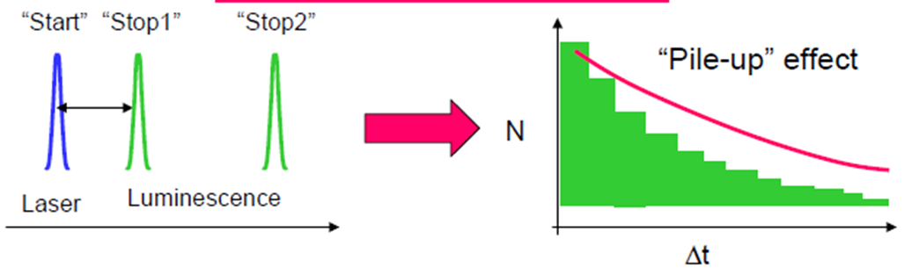
Intensity to High
Single Photon Counting only counts the first photon!
Limited number of emitted photons. Failure to do so can lead to a biasing towards detection of photons arriving at shorter times, a phenomenon known as pulse pile up.
Stop count rate < 2% of the excitation rate.

Slide 54
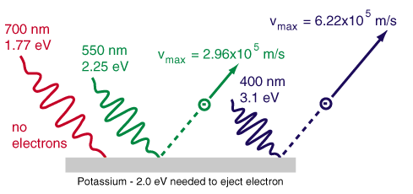
Side Note: PMT Lifetime
Photoelectric Effect
Photon Energy - binding energy = electron kinetic energy

Slide 55
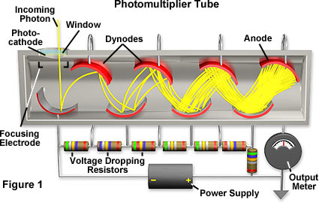
Side Note: PMT Lifetime
Photoelectric Effect
Photon Energy - binding energy = electron kinetic energy
Higher Energy Photons = Faster Signal
Measured Lifetime < Real Lifetime

Slide 56
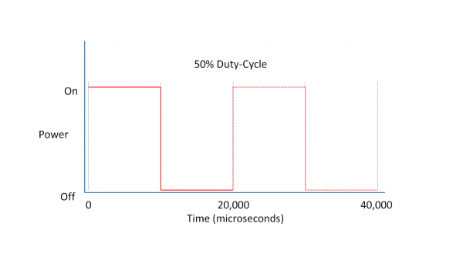

Streak-Camera
Temporal profile from Spatial profile
Laser Pointer Duty Cycle
Calculating Duty Cycle
Length (spatial)
Distance
Pointer Motion
m/s
Use length to calculate time

Slide 57
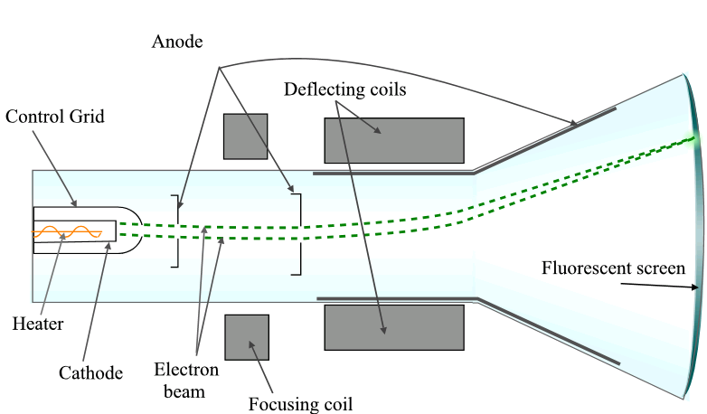
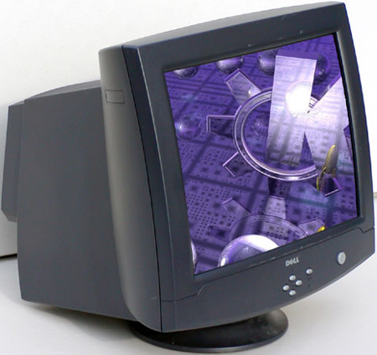
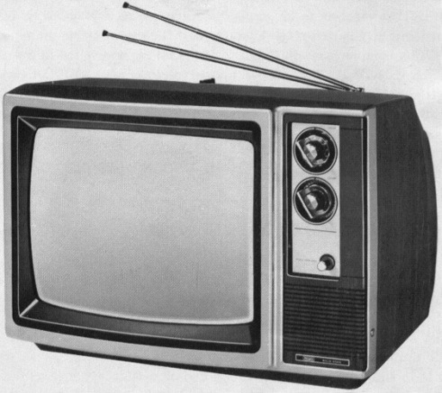
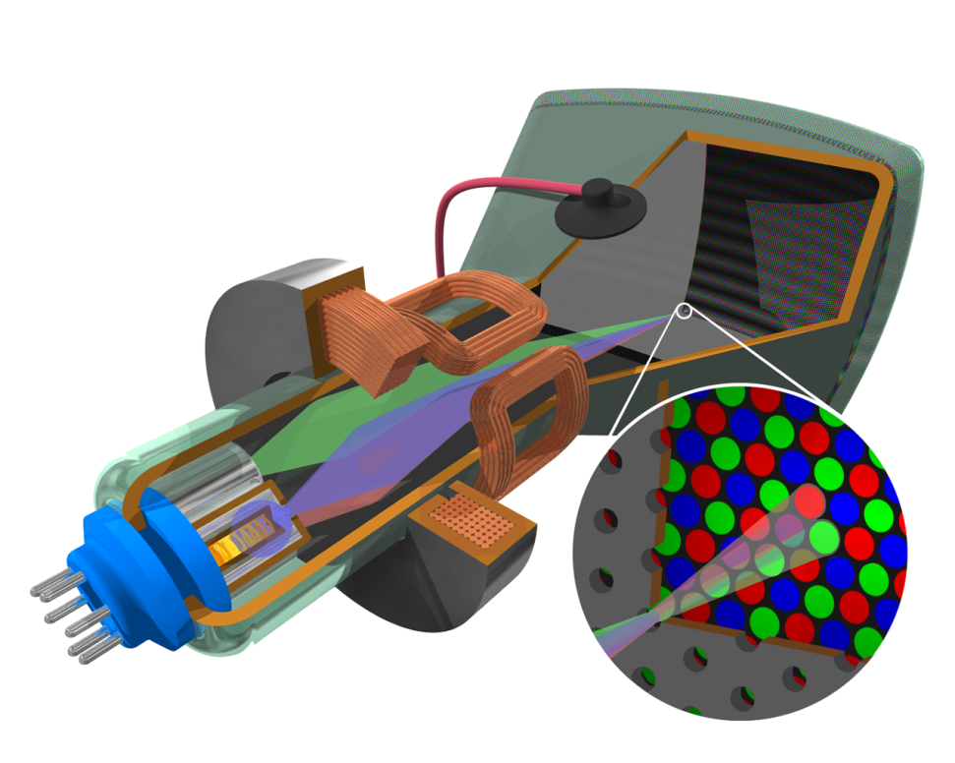
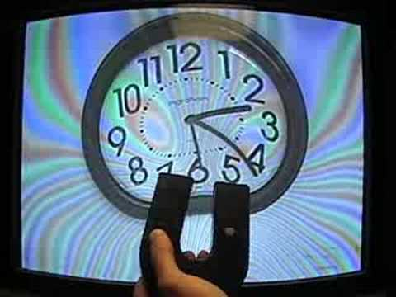
Streak-Camera
Cathode Ray Tube
+
e⁻
-

Slide 58
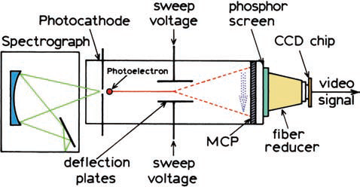
Streak-Camera
(4)
(1)
(2)
Source
(3)
hν
Sample
Monochromator
1) Light hits cathode (ejects e⁻)
2) Voltage sweep from low to high
3) e- hits MCP-Phosphor Screen
4) Emitted photos hit CCD detector

Slide 59
Streak-Camera
Calculating Duty Cycle
Intensity
Length (spatial)
Length
Distance
time(0)
time(t)
Pointer Motion
m/s
Sweep Rate
m/s
-
+
e⁻
Use length to calculate time
Use length and intensity to calculate lifetime

Slide 60
Streak-Camera
(4)
(1)
(2)
Source
(3)
hν
Sample
Monochromator
1) Light hits cathode (ejects e⁻)
2) Voltage sweep from low to high
3) e- hits MCP-Phosphor Screen
4) Emitted photos hit CCD detector

Slide 61
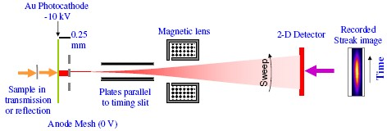
Streak-Camera
Electrons that arrive first hit the detector at a different position compared to electrons that arrive later.

Slide 62
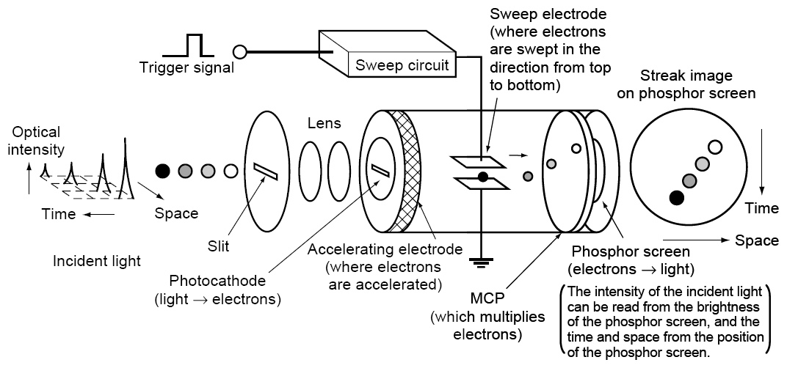
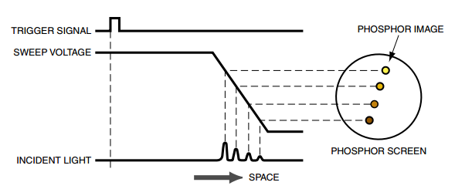
Streak-Camera

Slide 63
Streak-Camera
http://www.youtube.com/watch?v=rA6A7haKFwI

Slide 64
Streak-Camera
Advantages:
Direct two-dimensional resolution
Sensitivity down to single photon
Very productive
Not detector limited (like TCSPC)
Disadvantage:
Depends on high stability of laser
Limited time resolution: 2-10 ps
Needs careful and frequent calibration
Expensive

Slide 65
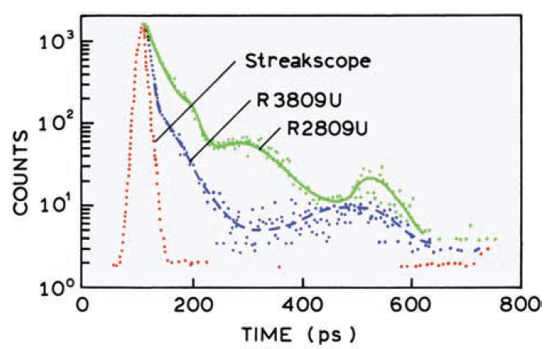
Streak-Camera
Instrument Response Functions
TCSPC
Time resolution down to 2ps or even 100s of femtoseconds.

Slide 66
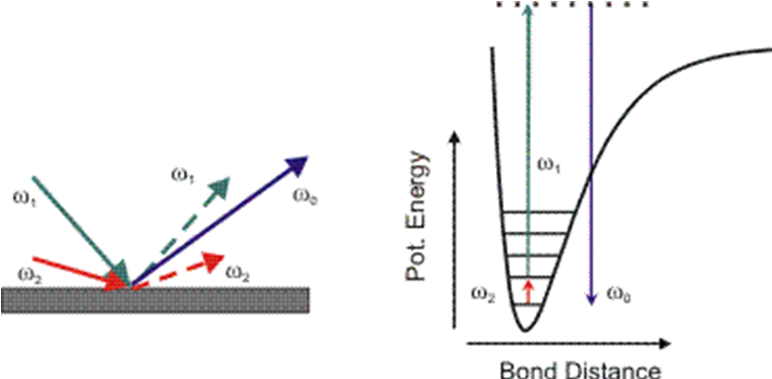
Fluorescence up-conversion
Sum Frequency Method
ω_{sum} = ω₁ + ω₂

Slide 67
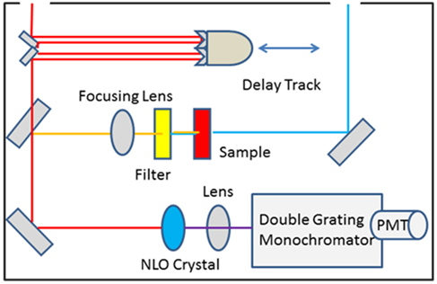
Fluorescence up-conversion
gate beam
excitation beam
(1)
(1)
(3)
(2)
(4)
(6)
(5)
1) Excitation pulse/gate pulse
2) Sample is excited
3) Sample Emission
4) Emission and Gate are collinear
5) NLO crystal sums Emission and Gate
6) Only Summed Light is measured

Slide 68
Fluorescence up-conversion
Excitation pulse
Graph of t_{d} vs intensity
Intensity
Emission
Intensity
time
time
Excitation pulse
Gate
pulse
Summed Light at time 1
Intensity
t_{d1}
Intensity
time
time
Excitation pulse
Gate
pulse
t_{d2}
Summed Light at time 2
Intensity
Intensity
time
time
Control t_{d} and measure only summed light

Slide 69

Fluorescence up-conversion
gate beam
excitation beam
(1)
(1)
(3)
(2)
(4)
(6)
(5)
1) Excitation pulse/gate pulse
2) Sample is excited
3) Sample Emission
4) Emission and Gate are collinear
5) NLO crystal sums Emission and Gate
6) Only Summed Light is measured
Signal is only measured when gate is pulsed
t_{d} is controlled by the delay track
Light Travels 0.9 m in 1 ns

Slide 70
Comparison
Sum Frequency Generation
TCSPC
Detector Bins
Intensity
Intensity
time
time
Control t_{d} and measure only summed light
Control excitation measure t_{d}
Detector is not time resolved (left open).
Not limited by detector speed.
Data point limited by pulse width (fs)
Limited by detector response.
Data point limited by PMT (10 ps)

Slide 71

Fluorescence up-conversion

Slide 72
Fluorescence up-conversion
Phys . Chem. Chem. Phys. 2005, 7, 1716 – 1725.

Slide 73


Fluorescence up-conversion

Slide 74
Fluorescence up-conversion
Advantage:
(very) high time resolution, limited mainly by laser pulse duration
Disadvantages:
Demanding in alignment
Limited sensitivity, decreasing with increasing time resolution (crystal thickness)
Required signal calibration

Slide 75


Decay Fitting
Exponential decay
Non-exponential decay
I(t)
= e^{-t/τ}
I(0)

Slide 76


Non-exponential Decay (Log)
Exponential decay
Non-exponential decay
Intensity
Intensity
Time
Time
I(t)
= e^{-t/τ}
I(0)

Slide 77


Non-exponential
Possible explanations:
- Two or more emitters
- In homogeneous samples (QDs)
- Dual Emission
- Multiple emissive sites
On surfaces
Polymer Films
Peptides
Dual Emission

Slide 78
Non-exponential Decay
Linear Scale
Biexponential Fit
I(t)
= A₁e^{-t/τ1} + A₂e^{-t/τ2}
I(0)
A₁ = amplitude of component 1
τ₁ = lifetime of component 1
A₂ = amplitude of component 2
τ₂ = lifetime of component 2
Log Scale
50 ns
5 ns

Slide 79

Non-exponential Decay
I(t)
= A₁e^{-t/τ1} + A₂e^{-t/τ2}
I(0)

Slide 80


Limitations of Multi-exponential Fits
Biexponential Fits
Linear Scale: No difference
Log Scale: minor differences at 30–50 ns
τ₁ = 5.5 ns and τ₂ = 8.0 ns
or
τ₁ = 4.5 ns and τ₂ = 6.7 ns
At 50 ns there are only about 3 photons per channel with a 1-ns width. The difference between the two decays at long times is just 1–2 photons.

Slide 81



Fitting Data

Slide 82




Multi-exponential Fits
The Data
Exponential
y = A₁e^{-k1t}
χ² = 26.466
Bi-exponential
Tri-exponential
χ² = 2.133
χ² = 1.194
y = A₁e^{-k1t} + A­e^{-k2t}
y = A₁e^{-k1t} + A­e^{-k2t} + A₃e^{-k3t}

Slide 83


It could be worse!
J. of Political Economy 2005, 113, 949

Slide 84
Time-resolved Emission End
Any Questions?

